Slide 1
Challenges in Multiple Regression
SSI II
March 5, 2019

Slide 2
Previously
Multiple regression
(Perfect) Multicollinearity

Slide 3
Essential Questions
What are some common problems that we face in multivariate regression and how do we deal with them?

Slide 4
Outliers and Influential Cases in OLS

Slide 5
Outliers
An individual case can be an outlier in several ways:
Unusual independent variable values – large “leverage”
Unusually large (squared) residual values
Both large leverage and large residual values

Slide 6
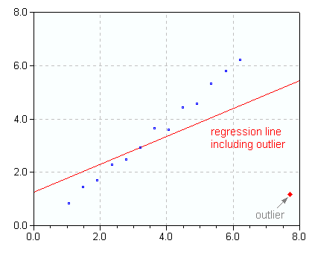
Outliers
Notes:
Source: http://www.statistics4u.com/fundstat_eng/cc_leverage.html

Slide 7

Influence
How large is the leverage and residual for a particular case?

Slide 8
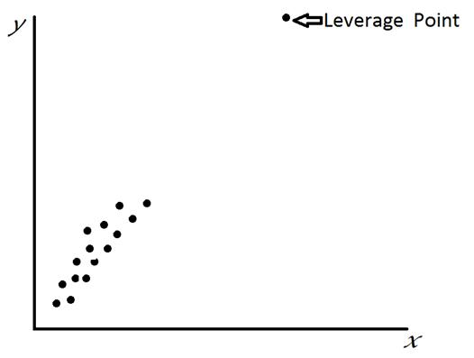
Leverage

Slide 9
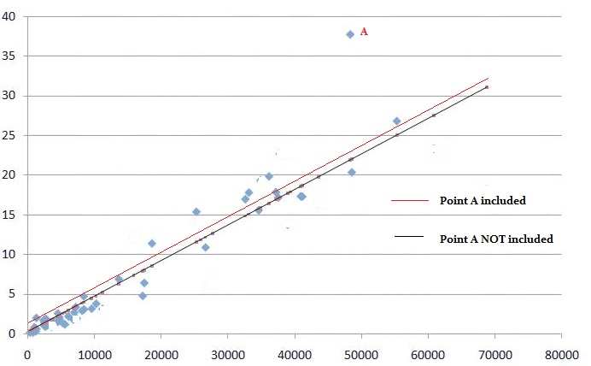
Large Residual Outlier
Notes:
Source: http://www.statisticshowto.com/wp-content/uploads/2013/09/linear-regression-leverage-1.jpg

Slide 10
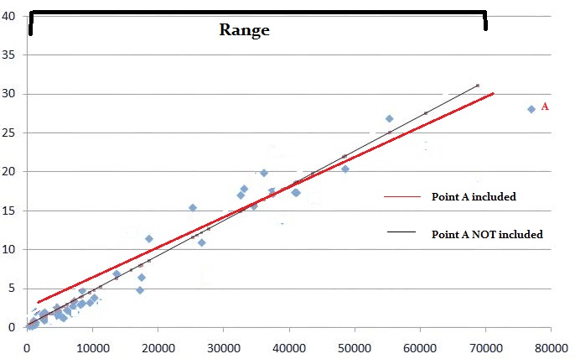
Leverage
Notes:
Source: http://www.statisticshowto.com/wp-content/uploads/2013/09/linear-regression-leverage-3.jpg

Slide 11

2000 Presidential Election
An attempt to find outliers/influential cases
Certain counties in Florida
Did ballot irregularities influence election results?
The raw vote numbers for candidates were the DV

Slide 12
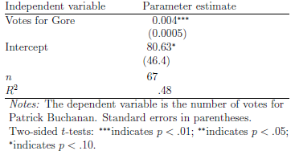
Florida Votes, 2000

Slide 13
Leverage vs. Residuals Plot

Slide 14
OLS line with scatter plot for Florida 2000

Slide 15
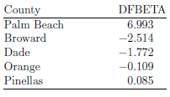
The five largest (absolute-value) DFBETA scores for β from the initial model
DFBETA scores are calculated as the difference in the parameter estimate without each case divided by the standard error of the original parameter estimate.

Slide 16
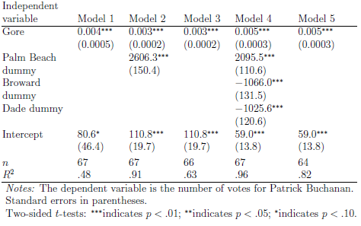
Models with “Dummying Out” Influential Counties

Slide 17
Cook’s Distance
Depends on the residual and the leverage
Summarizes how much all of the fitted values (predicted Y values) change when you delete the observation
If an observation has a large Cook’s distance measure, it strongly influences the fitted values (because it strongly influences the alpha and beta(s) used to predict those fitted values)

Slide 18
Cook’s Distance Formula
D_{i} is Cook’s distance
p is the number of parameters including the intercept
h_{ii} is the leverage

Slide 19
Leverage vs. Residuals Plots in R
> plot(mod7, which=5)

Slide 20
Leverage vs. Residuals Plots in R
In case 2, if you exclude observation #49:
The slope coefficient changes from 2.14 to 2.68
R-squared changes from .757 to .851
Notes:
Image credit: http://data.library.virginia.edu/diagnostic-plots/

Slide 21
Influential Cases
Be aware they exist
Be clear and honest about what you do with them
Possible solutions include:
Dropping them
Creating dummy variables for them
Leaving them
Combinations of these
Always double check they are not just a data entry problem, if possible
Is there a reason why they are unique?

Slide 22
Multicollinearity

Slide 23
High, but Less-than-Perfect, Multicollinearity
Or “multicollinearity”
Results from one or a combination of:
A small number of degrees of freedom (small N)
High correlation between independent variables
Makes it hard to determine the independent effect of each variable

Slide 24
Venn Diagram of Data with Multicollinearity

Slide 25
Detecting Multicollinearity
Pairwise correlations of your variables
High R² statistic with few significant parameter estimates
Parameter estimates change drastically when we add or remove variables
Variance Inflation Factor (VIF)

Slide 26

VIF
For each variable, you (R) run a regression model with that variable as the DV and the other IVs as the IVs
The R² from this model is used to calculate the VIF for that variable:

Slide 27
VIF – Rules of Thumb
VIFs above 4 reflect some multicollinearity and may warrant further investigation
VIFs above 10 reflect serious multicollinearity

Slide 28
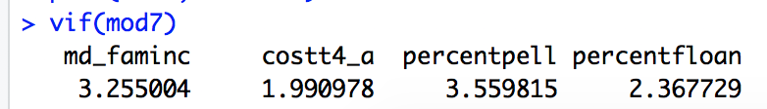
VIF in R
Uses the car package

Slide 29
Using Simulations to Demonstrate Multicollinearity
Create a population with:
Two variables, X_{1i} and X_{2i} such that the correlation between them is 0.9
A variable u_{i} randomly drawn from a normal distribution, centered around 0 with a variance equal to 1
A variable Y_{i} such that:

Slide 30

Our simulation
We will pull random samples of different sizes
We will test these three models:

Slide 31
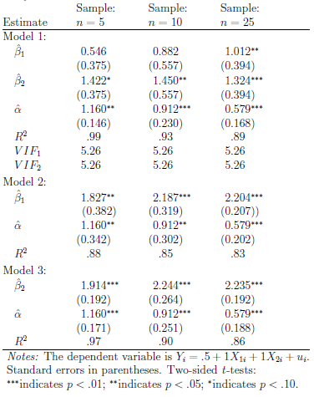
Simulation Results
Remember, the population model is:

Slide 32

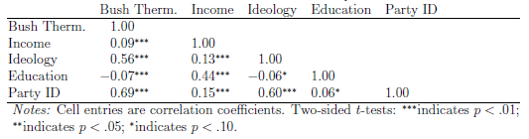
Bush Thermometer Model

Slide 33
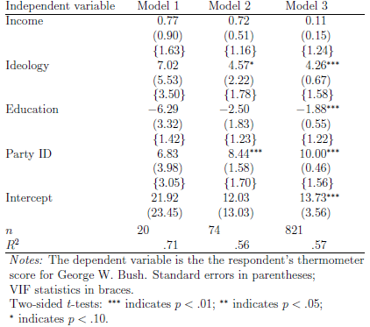
Bush Thermometer Model Results from Random Draws of Increasing Size from the 2004 NES

Slide 34
Finkel (2002) and Multicollinearity
“The same general pattern of interaction effects is seen in South Africa, though the collinearity between the various product terms renders the conclusions somewhat more tentative” (1013).

Slide 35
What to do about Multicollinearity?
No magical cure
Best solution is to collect more data… but that is more easily said than done
Live with it
Report it and its effects
Use joint significance tests

Slide 36
Significance Tests and P-Values – Be smart!

Slide 37
Statistical Significance
Based on p-value
Is a relationship due to more than chance?
Does not tell you about size or substantive significance

Slide 38
Substantive Interpretation
How big and important is the difference in real terms?

Slide 39
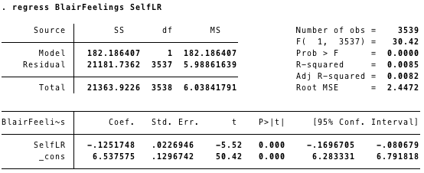
Significance vs. Substance

Slide 40
Significance vs. Substance
Significance
The t-statistic is -5.52 , which is relatively large
significant at the .001 level (p<0.000)
95% confidence interval is between -.1697 and -.0807 , which does not include 0, so significantly different from 0

Slide 41
Significance vs. Substance
Substance
If we feel comfortable saying that the difference in one a one point move to the right is consistent across each category, then we could say that as one becomes one point more conservative, we would expect that person, on average, to rate Blair .125 points lower.
The expected difference between someone who is extremely to the left and someone who is extremely to the right would only be a difference of about 1.2 points on the Blair rating
Not very large, substantively

Slide 42
Data Snooping/P-Hacking
Keep trying models until you get the result you want
Eventually, you may get the result you want by chance
Say, try 20 models at a .05 level of significance
Even if not this extreme, may just be due to model specification
Not a robust result
We want to avoid doing this! Use theory!

Slide 43
Essential Questions
What are some common problems that we face in multivariate regression and how do we deal with them?

Slide 44
Next Time…
What if we do not have a continuous dependent variable?
Logit/Probit

